Slide 2
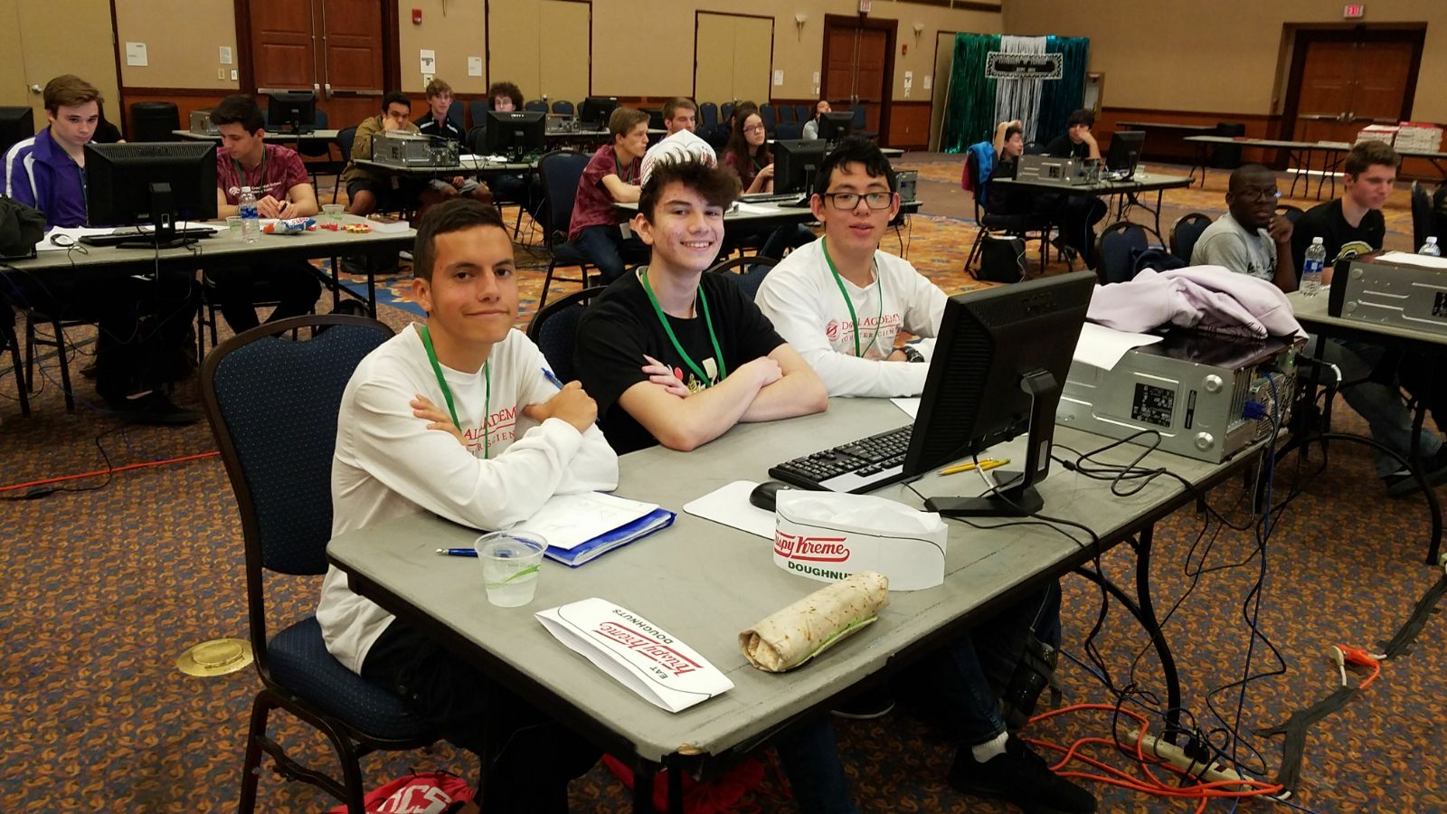

Slide 3
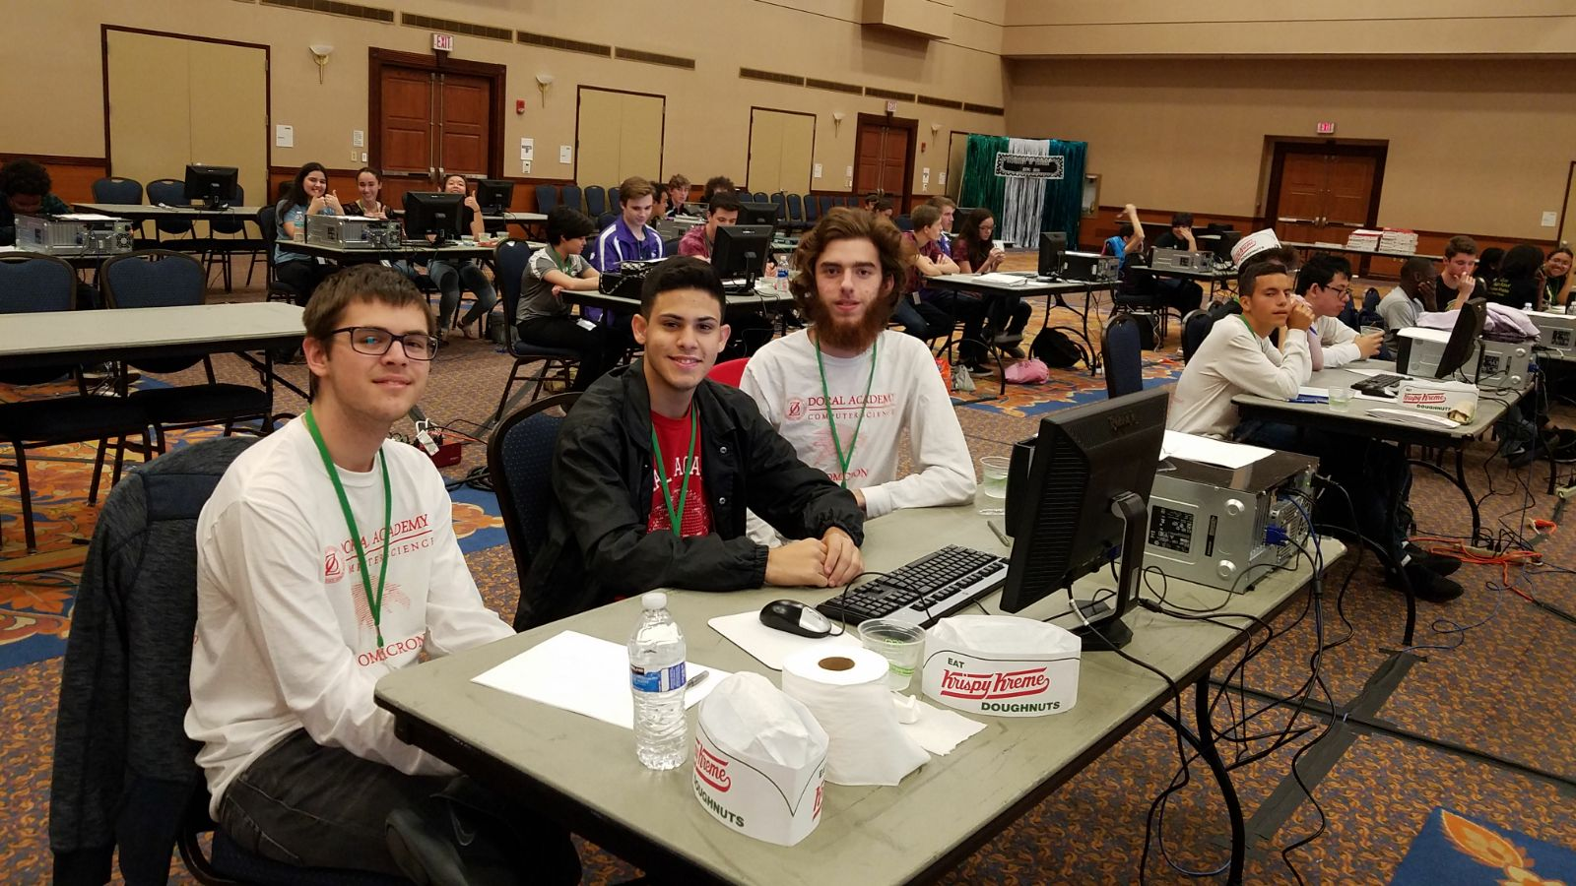

Slide 4
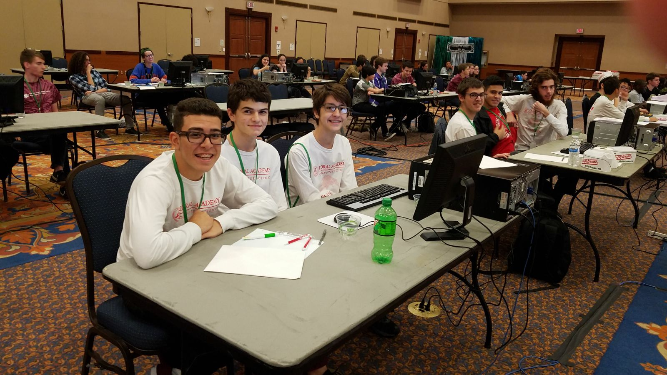

Slide 5
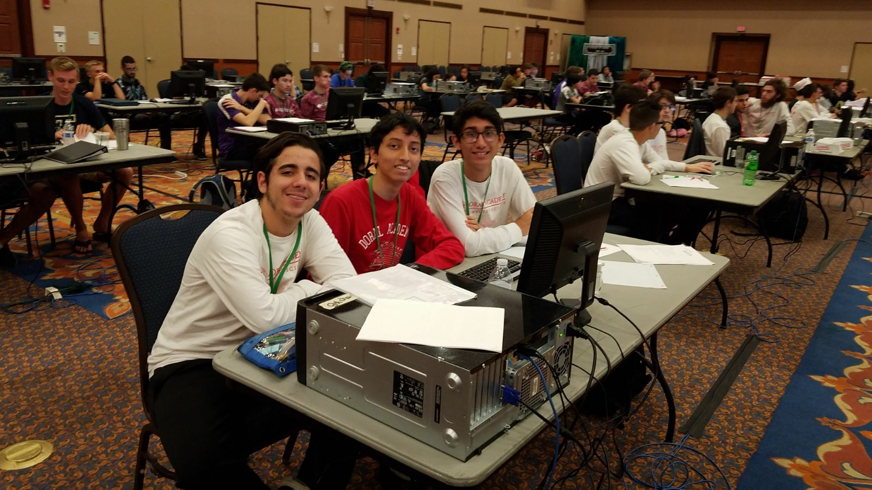

Slide 6
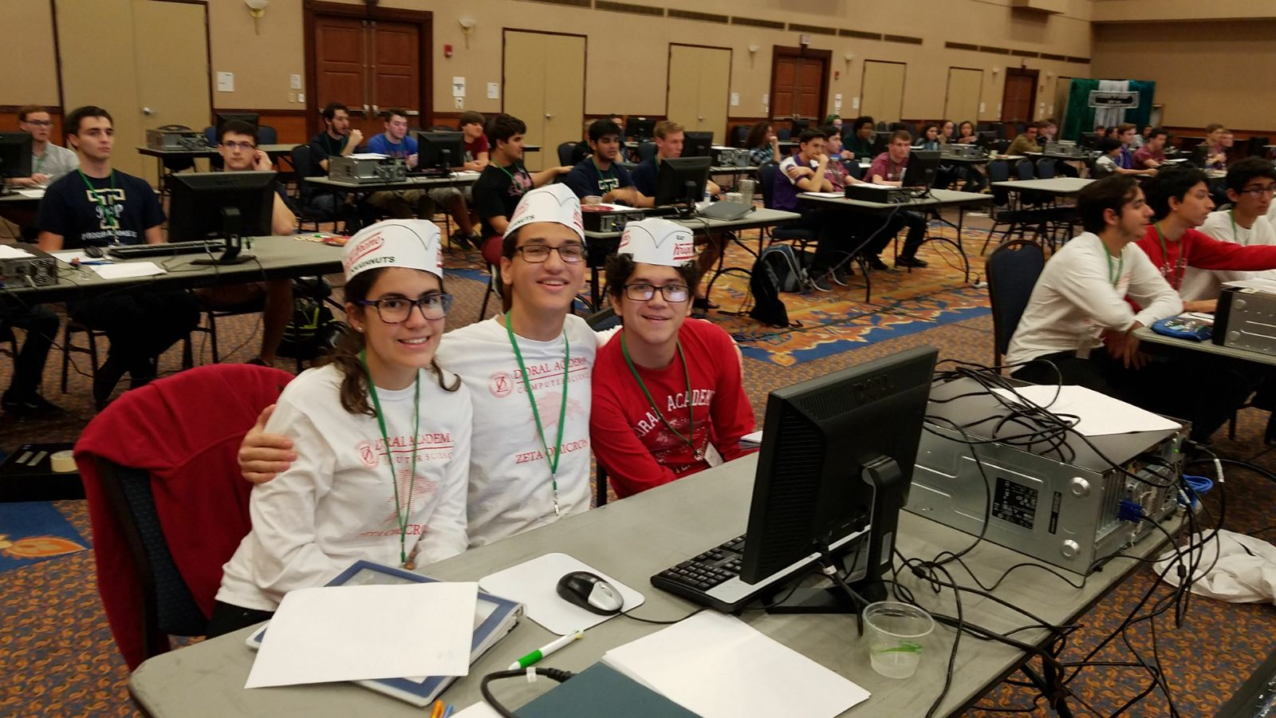

Slide 7
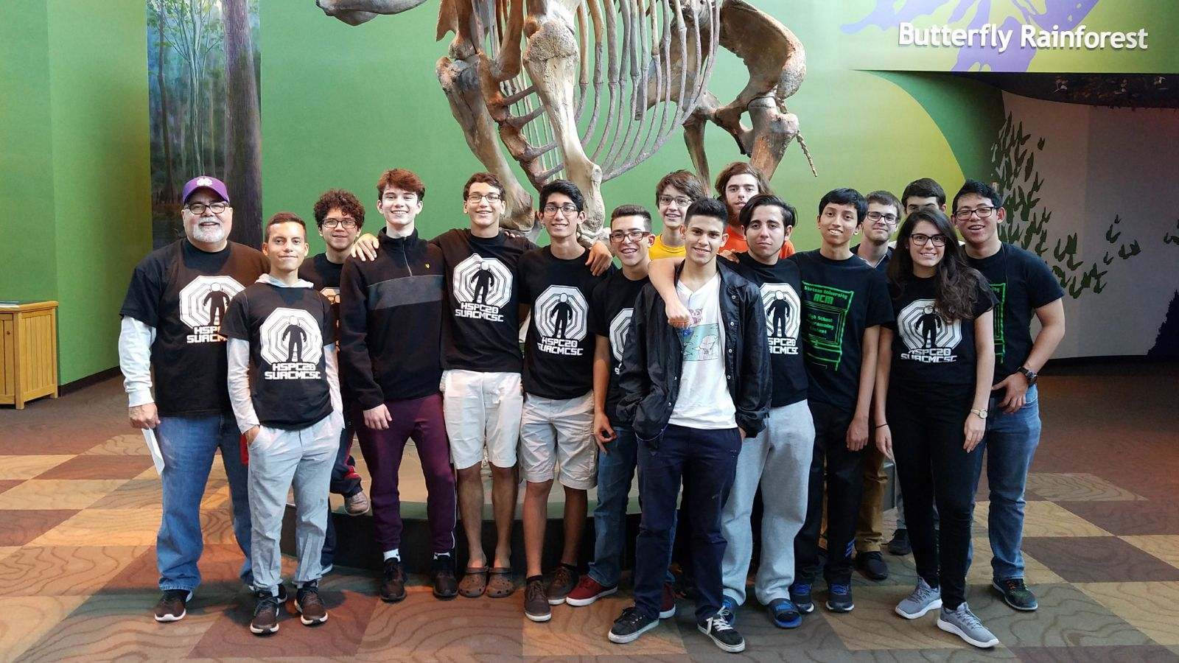

Slide 8
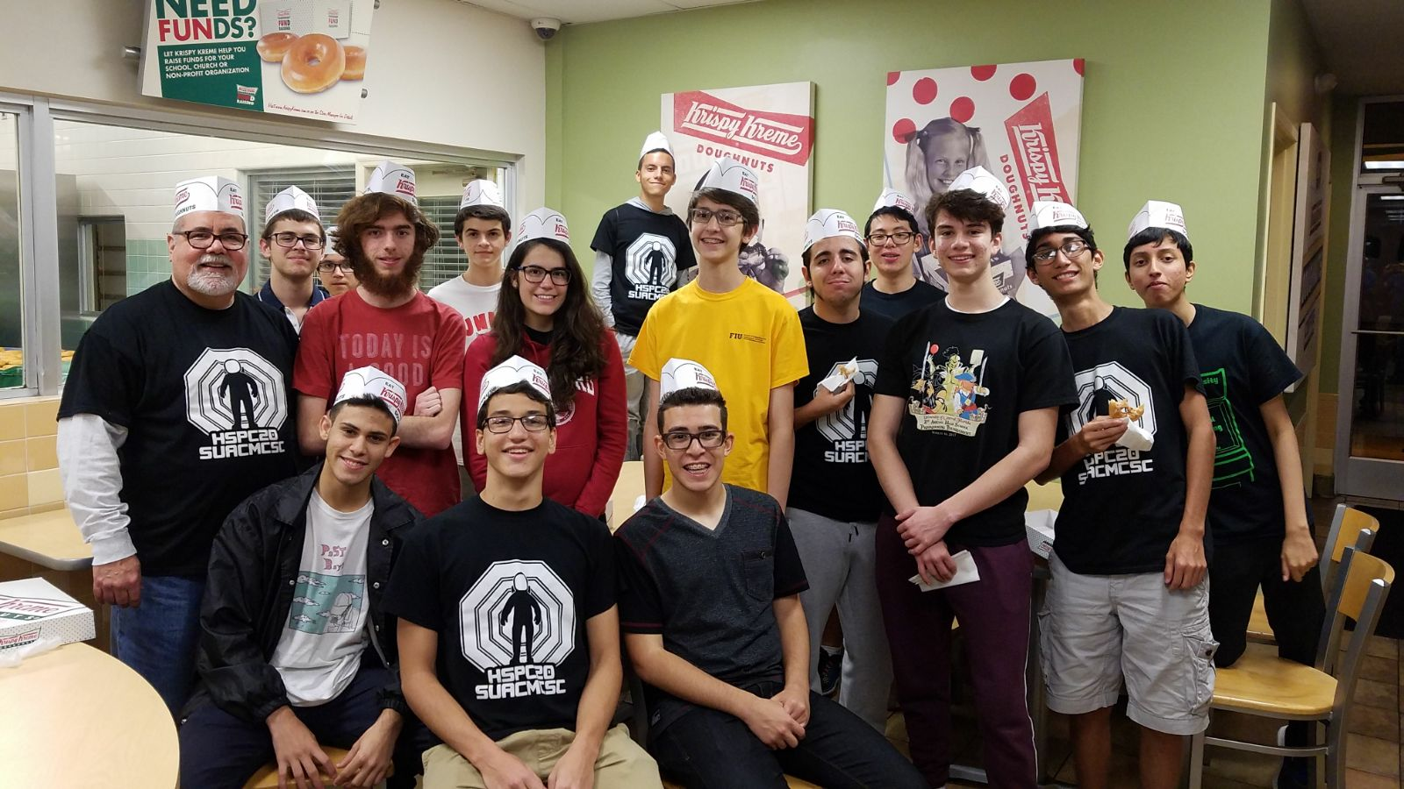

Slide 9
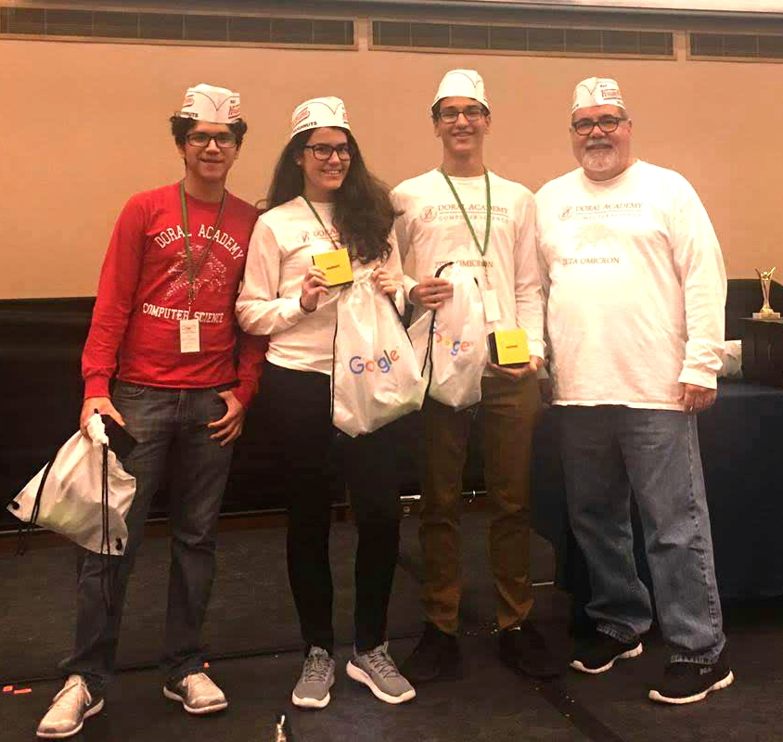
How to get 1st 2nd Place in the State
By: Pedro Contipelli

Slide 10

Manage Your Time
Early Game
Front, Middle, Back method
Easiest problems first
Mid Game
Analyze remaining problems and sort by difficulty
Assign roles (2 people for 1 harder problem, 1 for another)
Late Game
WORK WITH YOUR TEAM (that’s what they’re there for)
You will be tired and not thinking straight. Thoroughly review ideas

Slide 11
Diversify your team. Fill in the gaps.
Coding/algorithms person
Recognize standard problems immediately. Have code printed out to solve them.
If you’ve done it 1000 times before, you won’t choke the day of the contest
Math person
Know your algebra/geometry/trig formulas, find closed form solutions so you don’t TLE trying to do things iteratively
Middle man (Wildcard problem solver)
Solve new problems you’ve never seen before and help with communication

Slide 12
Describe Algorithms on paper
Don’t touch the computer until you have the entire program written in your head
If a team member is using the computer, write pseudocode on paper
You should always be doing something, don’t just “heat the seat.”
If you’re staring at a blank screen, you’re wasting time.
CHECK INPUT SIZES. Don’t kill an ant with a sledgehammer

Slide 13

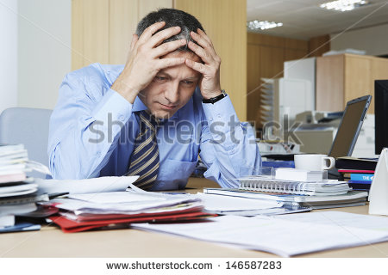
Debugging (THE WRONG WAY)

Slide 14
Debugging (THE RIGHT WAY)
Most common stupid mistakes
Submitting wrong file (can be prevented with good naming conventions)
Rogue debug print statements (CHECK before you submit)
Check judge output (TLE, Runtime Error, or Wrong Answer)
Isolate the error
Run through sample cases on paper
Run it by your other team members; explain the code to them line by line
Last but certainly not least: EDGE CASES / LARGE INPUTS

Slide 15
Problems Specific To Your Team
COMMUNICATE with your team.
After every contest, look at the scoreboard. Figure out what you can improve on
Identify mistakes
No one on your team is good at graph theory…
Not managing time correctly…
Getting tired after coding for 2 hours…
Explicitly plan out the steps you’re going to take to fix those mistakes and do better the next time

Slide 16
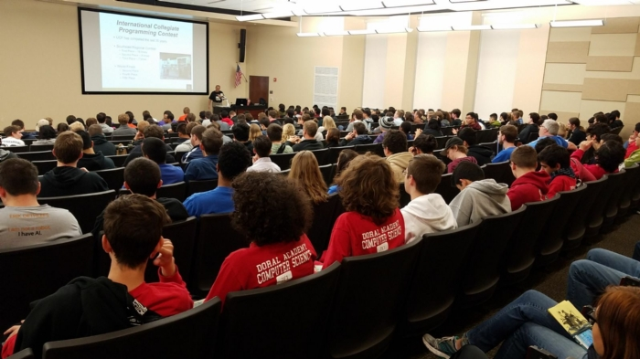

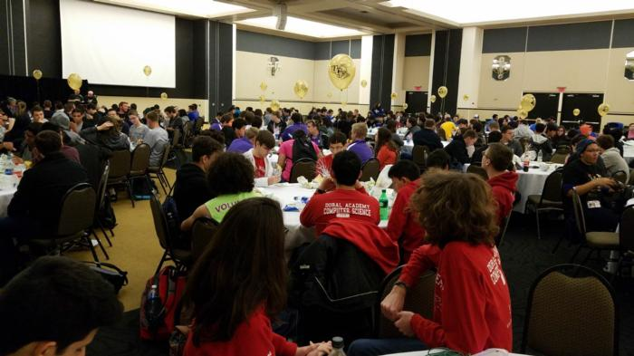
UCF Coming Up

